Slide 1

The importance of ICT accessibility
for persons with disabilities:
perspectives and experience from ITU
May 2016
www.itu.int/accessibility

Slide 2
Why ICT accessibility matters
www.itu.int/accessibility

Slide 3
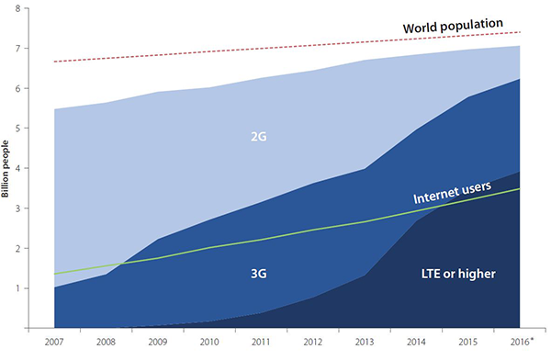
Information and communication technologies (ICTs) have become a key enabling infrastructure
No other infrastructure or technology has this same level of access

Slide 4
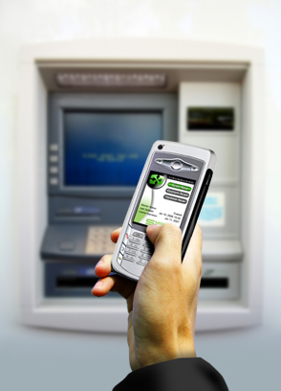




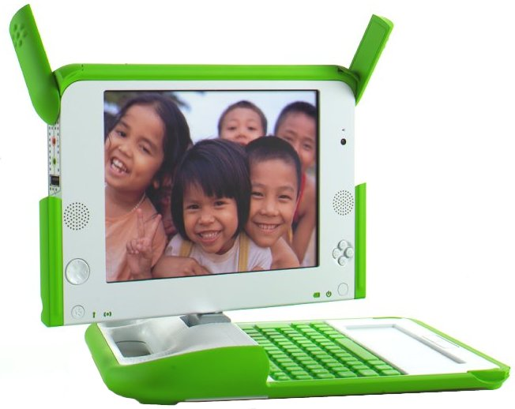

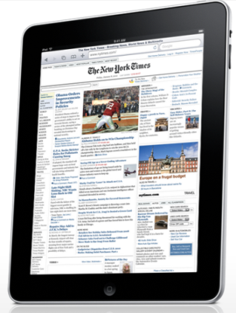
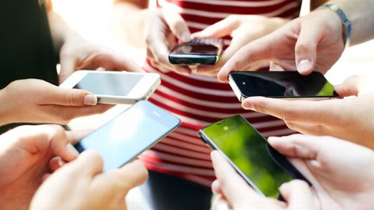
The use of ICTs is transforming the way we work, live, learn and interact

Slide 5

ICTs are fundamental to achieve the SDGs by 2030

Slide 6
ICTs are fundamental to enable the independent living of persons with disabilities
Access to key public services
  Health
  Education
  Government services
Opportunities to increase productivity and Access job market, including becoming entrepreneurs
Communicate

Slide 7
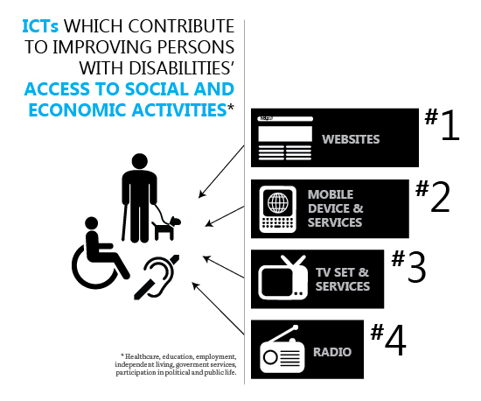

Slide 8
ICTs are a powerful equalizer of abilities, empowering persons with disabilities to fulfill their potential, dreams and ambitions
However to achieve this impact
ICTs have to be accessible otherwise ICTs will be introducing new barriers for persons with disabilities

Slide 9
Lack of ICT accessibility could become a barrier to access content, media, public services and event the job market

Slide 10
How to promote an accessible ICT sector?
By promoting Universal Design: role of standards
By creating regulatory/policy frameworks that encourage the private sector to implement access services + accessibility features
By creating accessible content, services and applications
By creating a dynamic market of access services:
  Role of public procurement
  Role of government as “super user” to create demand
By building capacity of users

Slide 11
ITU’s work in accessibility
Overview
www.itu.int/accessibility

Slide 12





About ITU
ITU is the United Nations specialized agency for information and communication technologies (ICTs)
Enabling a connected world
193
+700
+150
MEMBER STATES
PRIVATE SECTOR
ORGANIZATIONS
ACADEMIA
MEMBERS

Slide 13

Overview of what we do
Main current work on accessibility
ITU Radiocommunication
Supporting access services in digital TV + radio
Incorporating accessibility requirements in radio standards
Coordinating radio-frequency spectrum and assigning orbital slots for satellites
ITU Standardization
Establishing global standards
Incorporating accessibility requirements in ICT standards
‘Committed to
Connecting the World’
ITU Development
Advance role of public policy and regulation to promote accessible ICTs
Capacity building to policy makers
Bridging the digital divide
Advocating for the role of ICTs to promote inclusion of persons with disabilities
Advocate for the importance of ICT accessibility
Promote Connect 2020 accessibility target

Slide 14
Jose.Batanero@itu.int
www.itu.int/accessibility

Slide 15
Annex
ITU’s work in accessibility
Extended Overview
www.itu.int/accessibility

Slide 16
Inter-sectoral activities
Measuring and implementation of Connect 2020 accessibility goal
Participation in meetings of the bodies established by the UN Convention on the Rights of Persons with Disabilities
Implementation of ITU Accessibility Fund
Implementation of ITU Accessibility Policy across the organization to promote the participation of persons with disabilities in the work of the Union
Outreach, advocacy and communication activities
Encouraging all delegations to mobilize experts on accessibility for ITU meetings

Slide 17

ITU’s activities in the area of
ICT accessibility for persons with disabilities
ACTIVITIES IN
ITU Radiocommunication Sector (ITU-R)

Slide 18
ITU-R’s activities on ICT Accessibility
ITU-R Sector contributes to the wireless technological development through the production of Recommendations, Reports, Questions and Handbooks relating to persons with disabilities and persons with specific needs, and by so doing, to improve their accessibility and to reduce the overall Digital Disabilities Divide.
For the ITU-R meetings, in line with Resolution 175 (Guadalajara, 2010), an English live captioning service for specific ITU-R events including WRC, RA, RAG and ITU-R Study Group meetings has been provided since late 2013.
In addition to live captioning, since RA/WRC-15 in 2015, the captioning transcript archives are also available. ITU Members can also access these archives shortly after a session for which captioning is provided.

Slide 19
ITU-R Study Group 1(Spectrum Management)
ITU-R Study Group 1 (SG1) is carrying out studies in response to
Resolution ITU-R 54-2 (revised at RA-15) to achieve
harmonization for Short Range Devices (SRDs)
(including definitions of categories for instance for
audio applications including aids for the hearing impaired)
ITU-R Recommendation and Report on SRDs, including in particular
SRDs used for hearing aids or medical devices within SG1:
Recommendation ITU-R SM.1896 “Frequency ranges for global or regional harmonization of short-range devices (SRDs)” (SM.1896-0 (2011))
Report ITU-R SM.2153 “Technical and operating parameters and spectrum use for short-range radiocommunication devices” (SM.2153-5 (2015))
Other studies on SRDs are available in relevant ITU-R Reports of the SM series
(e.g. measurements, impact on radiocommmunication services, specific applications and techniques)

Slide 20
ITU-R Study Group 5 (Terrestrial Services)
ITU-R Study Group 5 (SG5) is carrying out studies to identify the suitable technical and operational characteristics, and conditions that might allow compatible operation of a short-range radiocommunication public access system supporting hearing aid systems at ITU-R SG5 WP5A in response to Resolution ITU-R 67 (2015).
ITU-R Recommendation and Question on wireless hearing aid systems within SG5
Recommendation ITU-R M.1076 “Wireless communication systems for persons with impaired hearing” (M.1076-1 (2015))
Question ITU-R 254/5 “Operation of short-range radiocommunication public access system supporting hearing aid systems” (Q.254/5 (2014))

Slide 21
ITU-R Study Group 6 (​​​​​​​Broadcasting Services)
ITU-R Study Group 6 (SG6) continues to actively participate in the ITU Intersector Rapporteur Group on Audiovisual Media Accessibility (IRG-AVA) (ITU-R SG6, ITU-T SG9 and SG16)
In line with Resolution 175 (Guadalajara, 2010), the SG6 Chairman actively contributed to ITU’s approach to the organizers of UEFA and the Paralympic Games 2016 in Brazil in order to promote accessibility services for their audiovisual coverages by 2016.
ITU-R Reports, Recommendations and Handbook on broadcasting service accessibility within SG6
Report ITU-R BT.2267 “Integrated broadcast-broadband systems” (T.2267-5 (2015))
Report ITU-R BT.2207 “Accessibility to broadcasting services for persons with disabilities” (BT.2207-2 (2012))
Recommendation ITU-R BS.1698 “Evaluating fields from terrestrial broadcasting transmitting systems operating in any frequency band for assessing exposure to non-ionizing radiation” (BS.1698-0 (2005))
Recommendation ITU-R BT.1702 “Guidance for the reduction of photosensitive epileptic seizures caused by television” (BT.1702-0 (2005))
”DTTB Handbook - Digital terrestrial television broadcasting in the VHF/UHF bands” (2002)

Slide 22
ITU’s activities in the area of
ICT accessibility for persons with disabilities
ACTIVITIES IN
ITU Standardization Sector (ITU-T)

Slide 23
ITU-T: mainstream accessibility in ICT standardization
mainstream accessibility in ICTs
  Develop standards (ITU-T Recommendations) on ICT accessibility
  Promote implementation of these standards
    3rd IPTV Accessibility Application Challenge, partner with International Paralympic Committee for Rio 2016 Paralympics
also making ITU-T accessible to PwDs
  Telecommunications Accessibility Checklist - ‘universal design’ principle
  Joint ITU/ISO/IEC ‘Policy on Standardization and Accessibility’ and ‘Guide for addressing accessibility in standards’ (ITU-T H Suppl. 17 (11/2014))
  Remote participation (to facilitate PwDs’ participation in ITU-T work)
  Reasonable accommodation of specific needs from PwDs – captioning, sign language interpretation, fellowship, etc

Slide 24
ITU-T’s recent publications on accessibility
ITU-T H.702 (11/2015) Accessibility profiles for IPTV systems
  This recommendation makes it possible for accessibility features like captioning, sign language, and audio description to be added to Internet Protocol TV and that this can be deployed with global interoperability.
ITU-T F.791 (11/2015) Accessibility terms and definitions
  This is the first consented UN standalone recommendation giving the correct definitions based on the UNCRD with consultation with persons with disabilities to be used by standard writers and others to be used in all respective documents in English.
Guidelines for supporting remote participation in meetings for all
  This is the first approved UN standalone technical paper giving instructions on how to organize and run an accessible remote participation meetings to include persons with disabilities taking into account both the accessible and in accessible aspects of the existing remote participation tools.
Guidelines for accessible meetings
  This is the first approved UN standalone technical paper giving instructions on how to organize and run an accessible meetings to include persons with disabilities.
ITU-T F.790 (01/2007)˝Telecommunications accessibility guidelines for older persons and persons with disabilities˝ - under revision
  This Recommendation gives guidance on understanding the topic of accessibility and the ways that accessibility may be incorporated in ICT products and services.
2014 - Overview of Disaster Relief Systems, Network Resilience and Recovery
2014 - Requirements for Disaster Relief System
ITU-T H.785.0 (10/2014) Digital signage: Requirements of disaster information services
2014 - New Annex A of E.161: Arrangement of digits, Korean Character set and symbols

Slide 25
ITU-T ongoing work items on accessibility
F.Relay: Multimedia telecommunication relay services
FSTP-UMAA: Use cases for assisting people with disabilities using mobile applications
H.ACC-MMD: Accessibility Features for Mobile Media Devices
H.ACC-MMSIGN: Abstract language for multimedia signing
H.ACC-RCAD: Requirements for captioning and audio description for accessibility
H.ACC-RDE: Application layer information specification at the terminal to network interface for people with hearing and speaking difficulties to request rescue to emergency rescue agencies
H.IPTV-ACC: Accessibility framework for TV-related services
HSTP.ACC-AUD: Technical Paper on Methods for improving the intelligibility of audio (or speech)
HSTP.ACC-Interop: Interoperability of digital audiovisual media accessibility
HSTP.ACC-SL: Production guidelines for sign language service
HSTP.ACC-UseCase: Use cases for inclusive media access services
E.FAST: User interface for face-to-face speech translation considering human factors
E.OKID: On-screen keyboards for ICT devices

Slide 26
ITU-T Accessibility Entities and meetings
ITU-T SG2
  Q4/2 Human Factors
ITU-T SG16
  Q26/16 accessibility
  Inter-sector Rapporteur Group (ITU-T SG9, 16 and ITU-R SG5)
Events:
  Q4/2, Q26/16, IRG meetings – every 6-8 months
  Workshops, showcasing, challenges, etc
  with ‘reasonable accommodation’ within available TSB budget:
  Captioning (accessibility related events +TSAG)
  Sign language interpretation for deaf
  Fellowship for delegates with disabilities
*DCAD (Dynamic Coalition of Accessibility and Disability) of IGF (Internet Governance Forum) – Convened by Andrea Saks, ITU(-TSB) serves as its secretary. Annual meetings since 2007

Slide 27
JCA-AHF
Joint Coordination Activity on Accessibility and Human Factors (JCA-AHF), reports to TSAG
Created in Dec. 2007 (reporting to SG2 until June 2015, now to TSAG)
chaired by Andrea Saks
Reports to TSAG
Terms of Reference
  increase awareness
  provide advice concerning the accessibility of ITU facilities and services
  coordinate among ITU-T SGs on mainstreaming accessibility into ITU-T standardization
  Communicate with other ITU Sectors and UN orgs
  Encourage participation of PwD in ITU(-T) work
open to personal membership: mailing list with 100+ people
  18 meetings since 2007 (latest 25 Jan 2016, 21 Oct 2015, 17 Jun 2015,…)
next meetings:
  19th meeting: June 2016, during SG16
Achievement: ITU internal & external coordination on issues related to PwDs

Slide 28
ITU’s activities in the area of
ICT accessibility for persons with disabilities
ACTIVITIES IN
ITU Development Sector (ITU-D)

Slide 29
Accessibility means what the user requires to gain functional access to ICT
ITU-D: assists members understand ICT accessibility and how they can promote it
If you cannot see a typical screen you need a way to understand what is on it:
Screen readers Audio description Tactile markers
Text to speech (TTS) Screen magnifiers
Gesture-based screen readers
If you cannot hear the information, you need a way to get that information:
Captioning and signing Video relay services SMS and MMS
Hearing aid compatibility Speech to text
Volume adjustment
i.e., provide alternative but equivalent ways of accessing ICTs

Slide 30
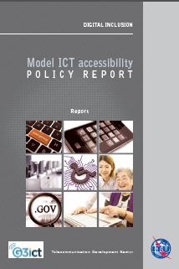
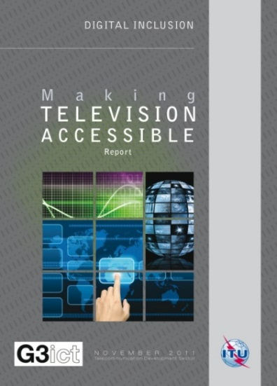
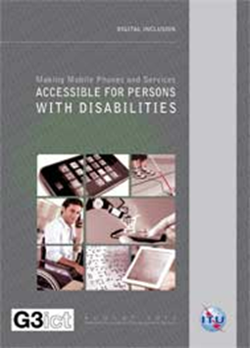
ITU-D Key publications
Model ICT Accessibility Policy Report
  Designed to assist Members transpose
  their Art. 9 CRPD obligations into national law
Making Television Accessible Report
  Explains TV accessibility and how to achieve it
Making Mobile Phones and Services Accessible Report
  Explains Mobile Accessibility and how to achieve it
http://www.itu.int/en/ITU-D/Digital-Inclusion/Pages/Reports.aspx

Slide 31
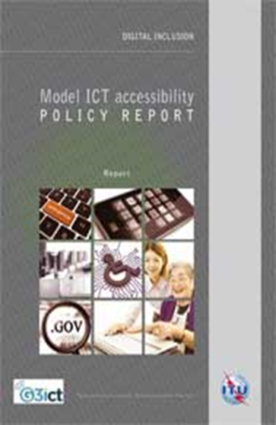
Model ICT Accessibility Policy Report: Module 5: WEB ACCESSIBILITY
Identify and create a list of all government websites covered by the policy (to be updated annually)
Conduct a gap analysis to assess the accessibility of existing government websites
Develop a transition plan with milestones and conformance metrics to achieve Level A and Level AA compliance with the WCAG guidelines
    includes staff training and updating procurement policies to ensure purchases of website development and services are performed accessibly
    guidance on accessibility testing tools and procedures
    establishing measurable targets and
    monitoring and publishing progress made by government websites
Encourage voluntary compliance by private websites
Explains to policy makers the concrete outcomes the policy is designed to achieve to demystify accessibility:
  E.g. website compatibility with screen readers, provision of ALT TXT for images, captions for videos and apps, navigation through use of alternative input devices
Calls for development of the national policy in consultation with persons with disabilities and conducting periodic reviews to address changing technological developments and market conditions
Based on Web Content Accessibility Guidelines (WCAG 2.0)- (ISO/IEC 40500:2012)

Slide 32
BDT Capacity Building & Awareness Raising
ITU Academy course on public procurement of accessible ICTs
ITU Academy course on accessible audio visual media
Arab, CIS and Europe Regional Initiatives on ICT Accessibility
  Awareness raising meetings, training and partnerships with key stakeholders
Accessible Americas
ITU-D Study Group Question 7/1 on ICT Accessibility
  competition on the best strategies/policies/projects developed by ITU members in area of ICT accessibility – deadline for contributions is due by 19 February
Raise awareness in meetings of Pacific Disability Forum, M-Enabling Summit and UN DESA/UN HABITAT meeting on accessible urban development

